Slide 1

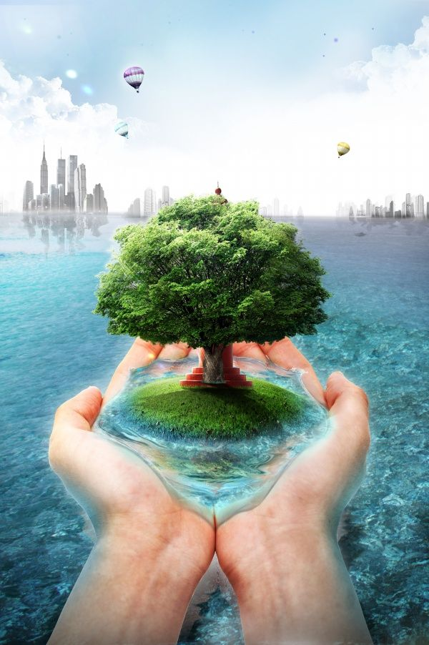
Environmental biotechnology
Dhanushika – HS21907852
Kareendra – HS21909214
Dilanka – HS21909900
Sankani – HS21908842
Ishini- HS21909978
Umanga – HS21908392
Udari- HS21922916

Slide 2
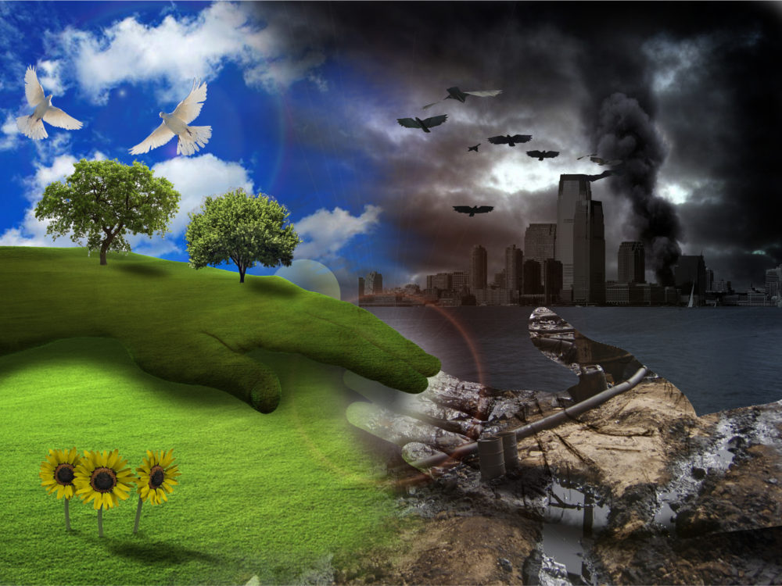
Environmental biotechnology
What is a environmental biotechnology ?
branch of biotechnology that uses biological processes to solve environmental problems such as pollution removal, renewable energy generation or biomass production.
It deals with,
Products for bioremediation.
Disposal waste treatment and water conservation .
Which microorganisms in pollution control .
How do we product biomass energy .
Occurs biodegradation and how it be prevent .
Degraded lands and biodiversity conservation.

Slide 3

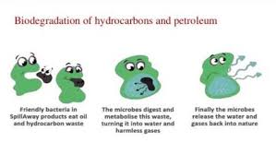
Bioremediation
What is the Bioremediation?
Bioremediation is the use of microorganisms to degrade environmental contaminants into less toxic forms.
There are two types of Bioremediation
Microbial Bioremediation
Phytoremediation

Slide 4
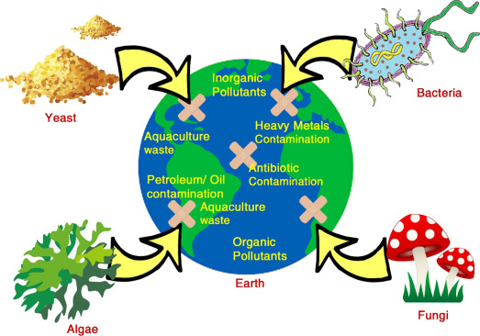
There are two strategies of Bioremediation
In-situ bioremediation
Ex-situ bioremediation
Advantages of Bioremediation
The complete destruction of target pollution is possible.
Useful for complete destruction of wide variety of contaminants.
Disadvantages of Bioremediation
Takes longer time than other treatment processes.
Limited to only biodegradable compounds

Slide 5
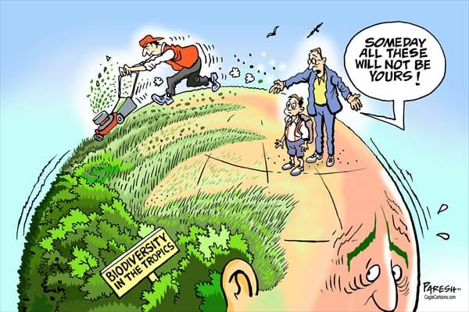
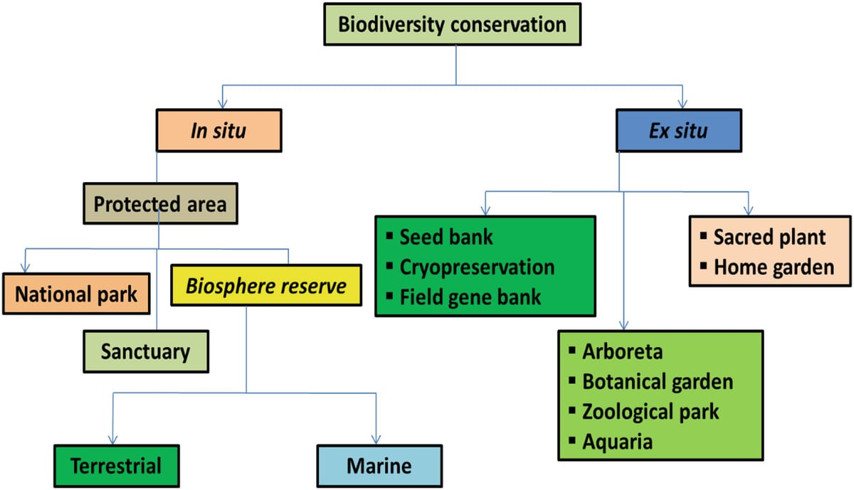
Biodiversity conservation
What is Biodiversity Conservation?
Bio Conservation means protecting, improving and managing biodiversity in order to bring sustainable benefits to present and future generations
Types of biodiversity conservation
In-situ conservation - Species protection in their natural habitats
Ex-situ conservation - Species protection outside their habitats

Slide 6
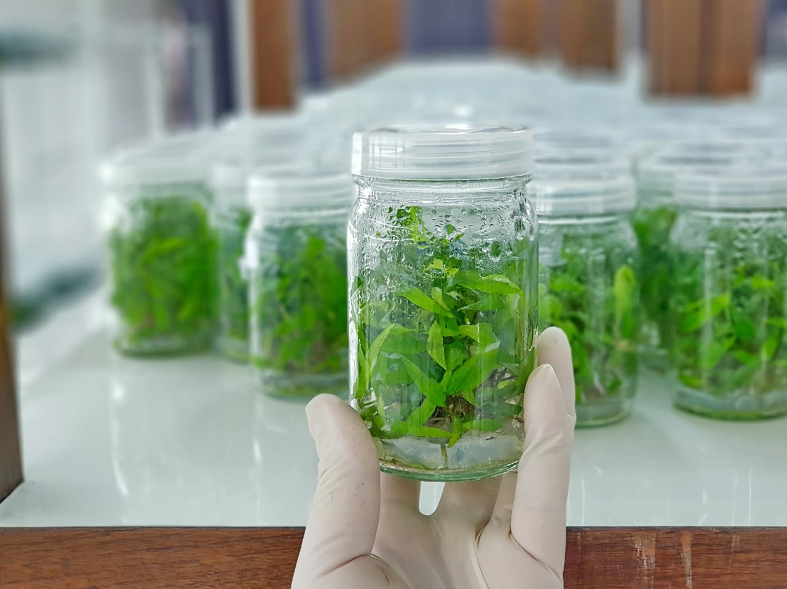
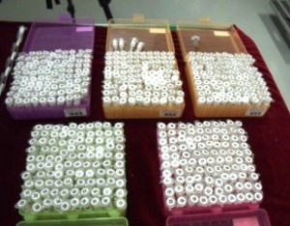
Various Biotechnological strategies for Biodiversity conservation
Tissue Culture/ Seed banks
Genetic Transformation
DNA Banks
Advantages
Faster growth plants and animals
Minimal space requirement
Disadvantages
Very expensive to maintain the system
Flustering the natural ecological balance

Slide 7
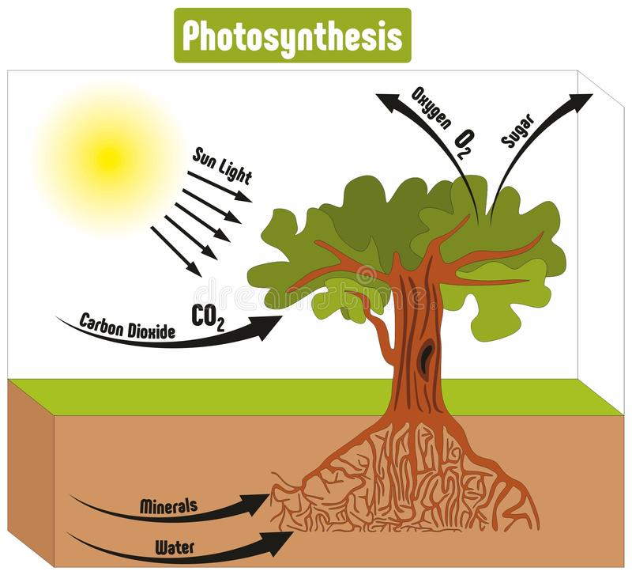
Biomass energy
What is biomass energy?
Biomass is a plant or animal substance that is used as fuel to generate electricity or heat.
Types of biomasses are,
Wood and agricultural products
Solid waste
Landfill gas and biogas
Ethanol
Biodiesel
There’s an important process called photosynthesis which store energy in plants from sunlight.
In photosynthesis process plants transmute radiant energy from the sun into the chemical energy in the form of glucose.

Slide 8
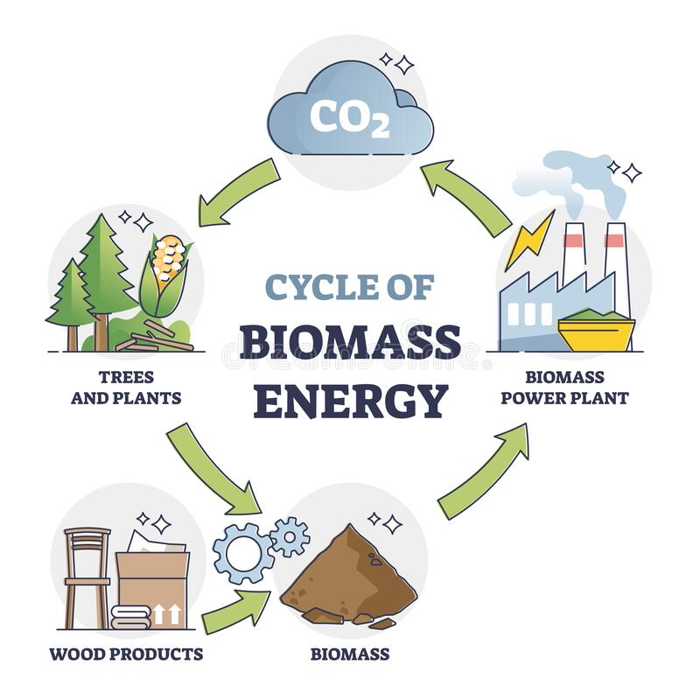
Advantages
It uses things that we use to throw away.
Doesn’t need fossil fuels.
Renewable energy and no harmful emissions.
Reduce dependency on fossil fuels.
Disadvantages
It causes air pollution by burning waste.
Extraction process is expensive.
It’s need large land to the process.
There may not be enough to grow biomass crops

Slide 9
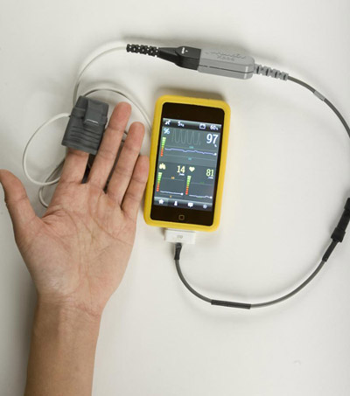
Biosensors and Bio-monitoring
What is the bio sensor?
Biosensor is an analytical device containing an immobilized biological material, which can specifically interact with the analyte to produce a signal that can be measured
A biosensor has two components,
Biological components : Enzyme, Hormone, Antibody etc.…
Physical components: Transducer, Amplifier
Types of biosensors
Electrochemical
Opto-electric devices
Electric
Thermistor

Slide 10
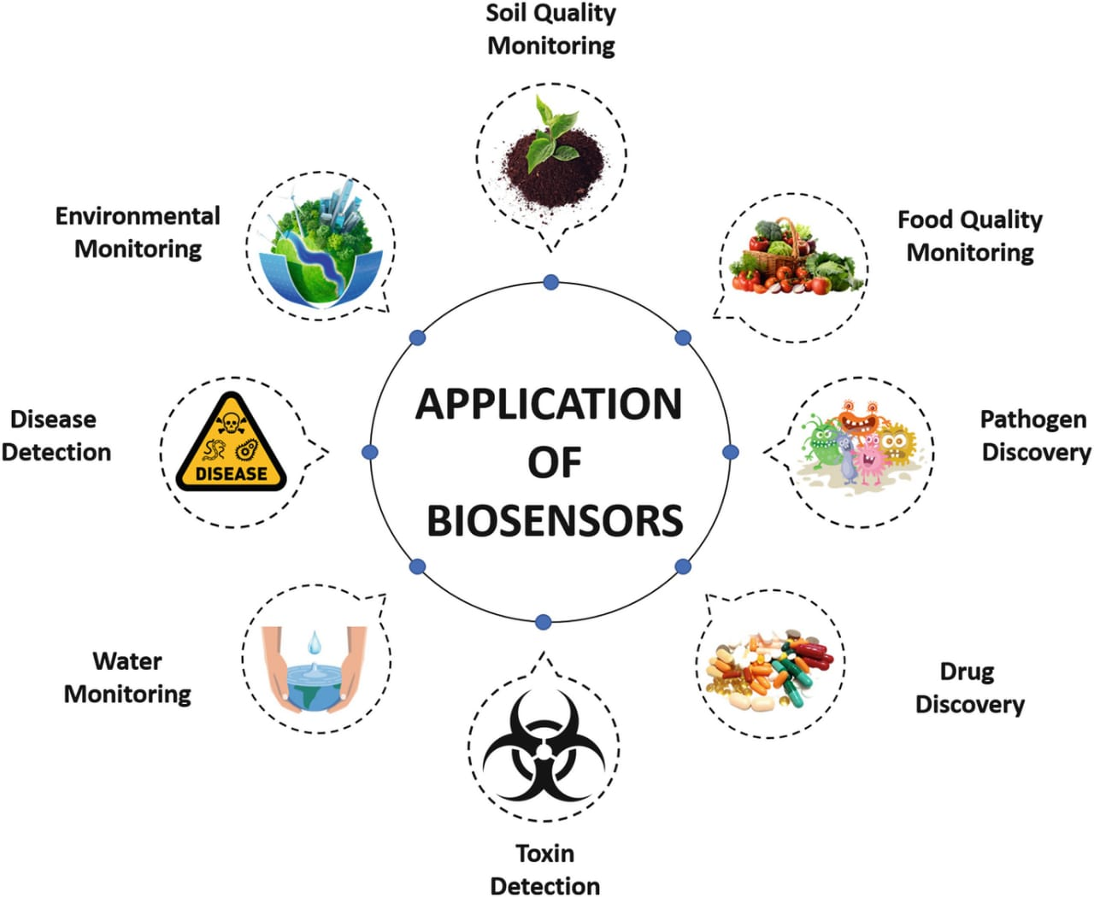
Advantages
Rapid and continuous control is possible with biosensors
Biosensors are specific due to the immobilized system used in them
Disadvantages
Heat sterilization is not possible because of denaturation of biological material.

Slide 11
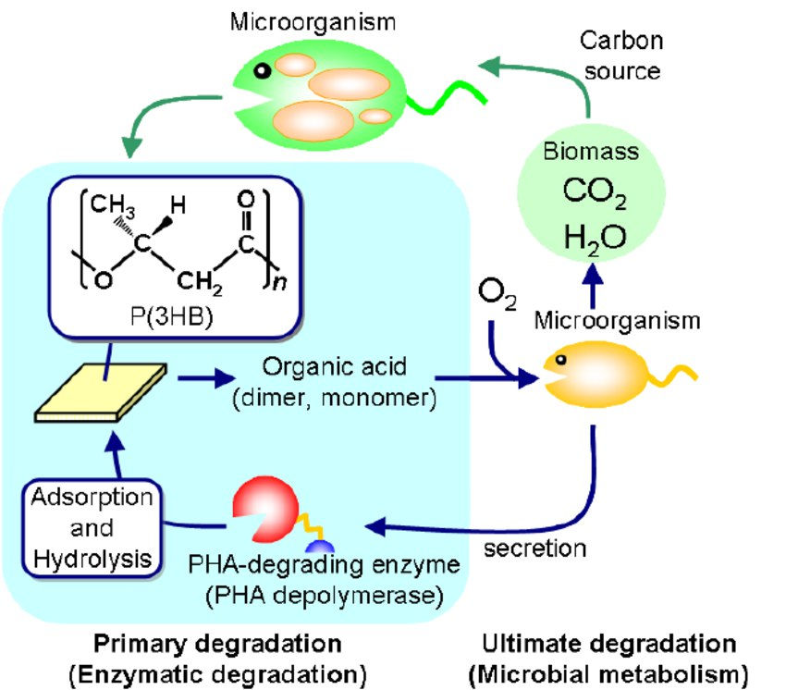
Biodegradation
What is biodegradation?
Process of breaking down the organic matter into simple substances such as carbon dioxide, water by microorganisms such as bacteria and fungi.
Types of biodegradations
primary biodegradation
ultimate biodegradation
Factors affecting biodegradation
Environmental condition
Micro organisms
Compounds to degrade

Slide 12
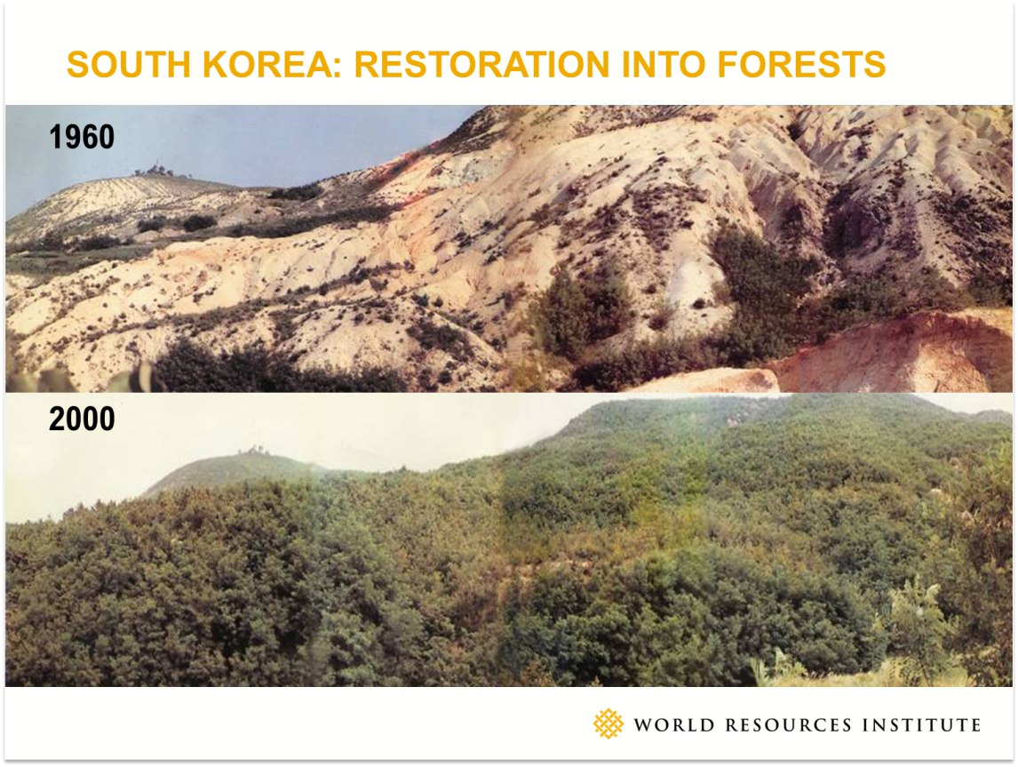
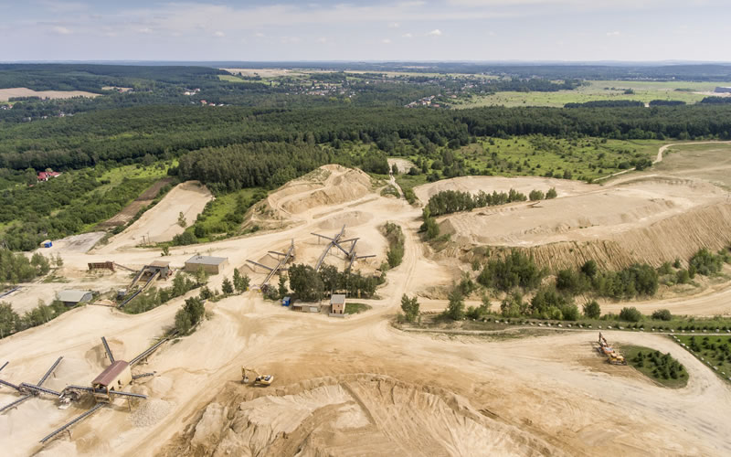
Restoration of degraded lands
Causes for degraded lands
Deforestation
Excessive use of fertilizers
Soil erosion
Desertification
Restoration
Process of ecological restoration of a site to natural landscape or habitat.
This can be done through Bioremediation by increasing fertility of land

Slide 13
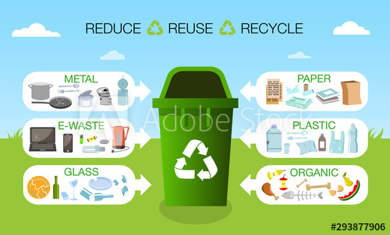
Waste treatment
What is waste treatment?
Application of science and technology as a treatment and disposal of waste without disturbing ecosystem.
Ways of solid and waste water treatment
Thermal treatment
Dumps and landfills
Biological waste treatment
Activation sludge
Oxidation ponds
Benefits
Improve water and air quality
Reduce pollution and energy consumption
Protection of environment and health of the population

Slide 14
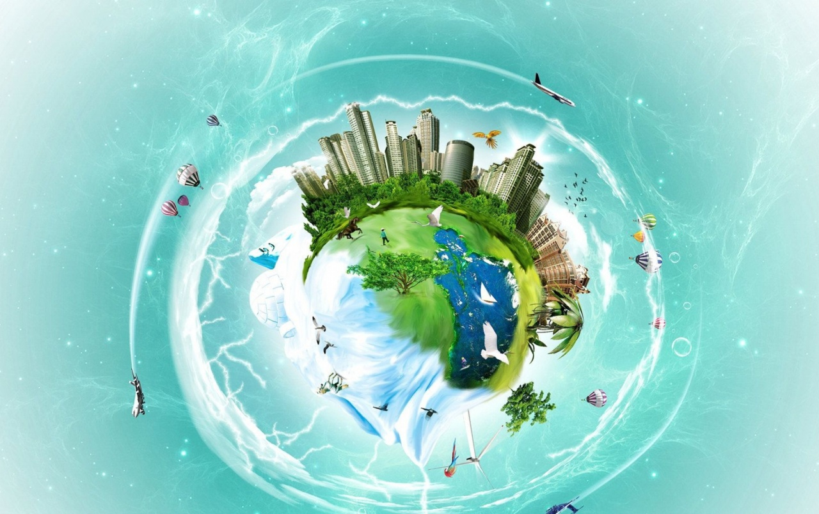

Green lifestyle helps to save money by reducing health bills, by eating healthy foods , breathing healthy air and drinking clean water . So if you want a healthy lifestyle, think green and act green !
THANK YOU

